Slide 1



Auction Summary
Conducted for Carpet & Related Services
Sabre, Inc.
February 1, 2001

Slide 2
RFQ Summary
An RFQ was created by Sabre, Inc. to procure carpet and related services.
Number of Participants: 3
Number of Lots: 2
Auction Date: February 1, 2001

Slide 3
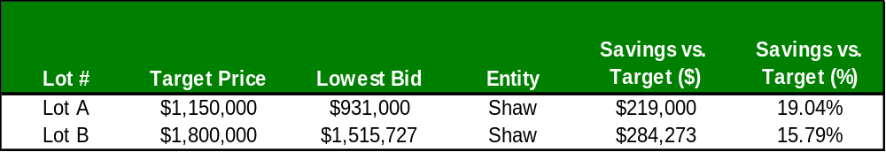
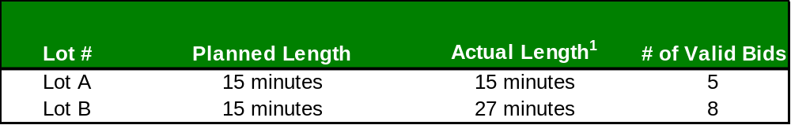
Sabre, Inc. Auction Summary
  ¹ Actual Auction lengths may be longer than planned given auction extensions during the Quiet Period.

Slide 4
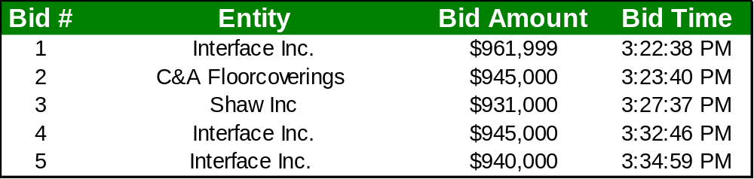
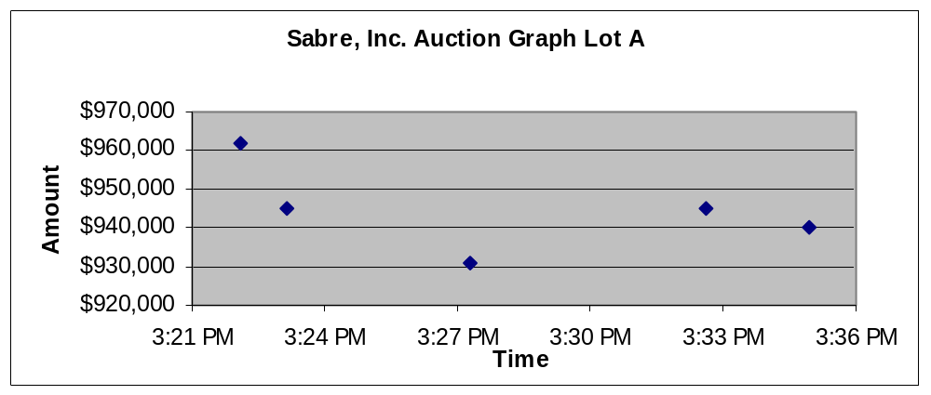
Sabre, Inc. Auction Summary
Lot A
Best Bid
Target Price set at $1,150,000

Slide 5
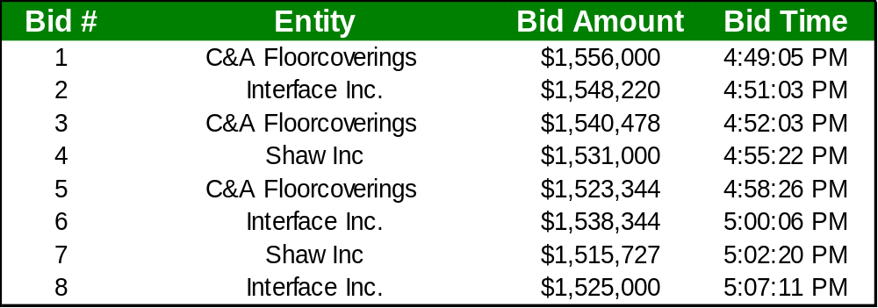
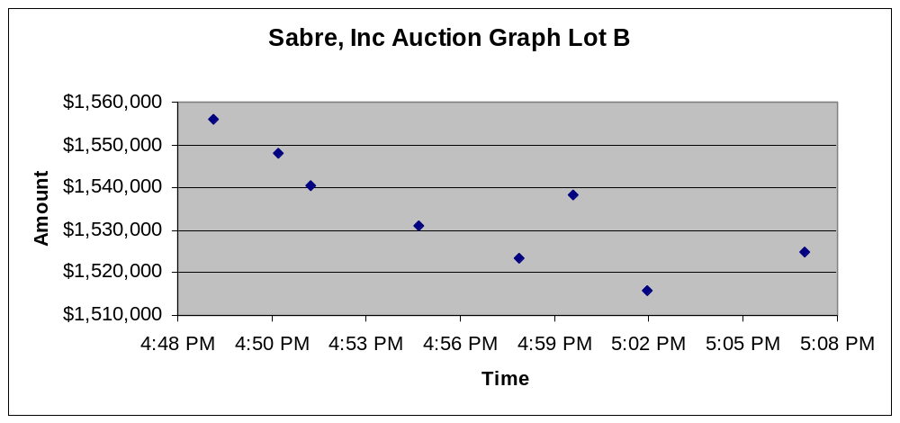
Sabre, Inc. Auction Summary
Lot B
Best Bid
Target Price set at $1,800,000

Slide 6
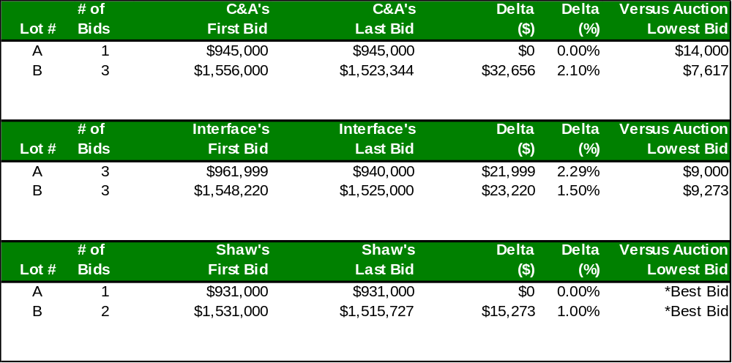
Bid History
Per Participant

